Slide 1
Keep On Following the Yellow Brick Code
An Extended Terminology Journey
Rob Hausam MD HL7 Working Group Meeting Phoenix, AZ
2023-09-23

Slide 2

This presentation
Can be downloaded here:
https://github.com/FHIR/documents/blob/master/presentations/2023-09%20Tutorials/Keep_On_Following_the_Yellow_Brick_Code_2023-09-13.pptx
Is licensed for use under the Creative Commons, specifically:
Creative Commons Attribution 3.0 Unported License
(Do with it as you wish – just give credit)
Acknowledgements: Jim Steel, Dion McMurtrie, Grahame Grieve, Lloyd McKenzie
2

Slide 3
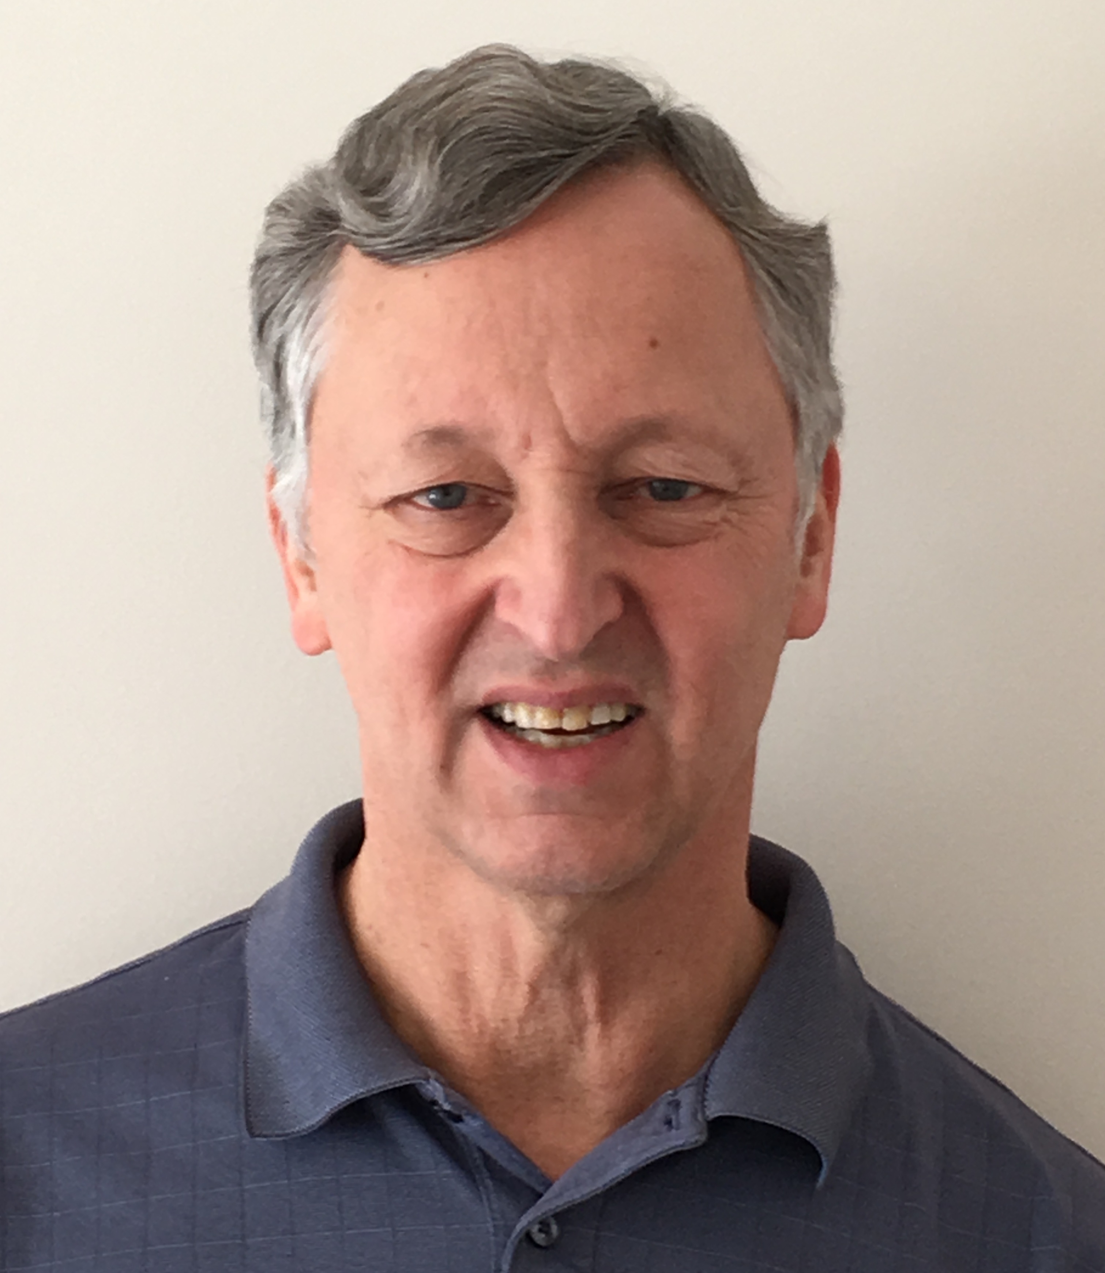
Who am I?
Name: Rob Hausam MD
Company: Hausam Consulting LLC
Background:
Co-chair of Terminology Infrastructure (TI) (formerly Vocabulary) and Orders and Observations (OO) WGs
FHIR specification and Terminology Module editor
Actively involved in HL7 and terminology standards/development and modeling for 22+ years
SNOMED on FHIR project co-lead (joint project of HL7 and SNOMED International)

Slide 4

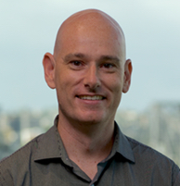
But credit is really due here…
Jim Steel
Senior Software Engineer, Health Data & FHIR CSIRO Australian e-Health Research Centre
Software Engineer on Ontoserver
Dion McMurtrie
Team Lead, FHIR and Terminology Tooling
CSIRO Australian e-Health Research Centre

Slide 5
What we will cover today
Follow some coded data through a journey, including
How the codes get found in the first place
What they look like on the wire
How they get validated on receipt
How they get queried
Images from Project Gutenberg http://www.gutenberg.org/ebooks/43936

Slide 6
What we will cover today (depending on interest and time)
Further advanced topics for exploration (time permitting)
New $expand ‘property’ parameter
Terminology-based searching
Expression Constraint Language (ECL) in value set definitions
FHIR implicit value sets
Code system supplements and fragments
R5 ConceptMap updates
UTG and THO
Images from Project Gutenberg http://www.gutenberg.org/ebooks/43936

Slide 7
What we will cover today (depending on interest and time)
Additional details of FHIR terminology and terminology service operations that are of interest to you
Images from Project Gutenberg http://www.gutenberg.org/ebooks/43936

Slide 8
FHIR Terminology resources
Concept Map
A (one way) mapping from a set of concepts to one or more other concepts
$lookup $validate-code $subsumes
Source
Target
N
N
Value Set
A selection of a set of codes for use in a particular context
Value Set
A selection of a set of codes for use in a particular context
Selects
from
Selects
from
N
Code System
A set of concepts with a coherent meaning
url, version, name, …
Filters, Properties
Concepts
Code
Display
Definition
src | rel | tgt
N
Code System
A set of concepts with a coherent meaning
url, version, name, …
Filters, Properties
Concepts
Code
Display
Definition
$expand $validate-code
$translate $closure

Slide 9


Terminology API in a FHIR Architecture
As part of a standard FHIR server
Simple, easy for clients
Separate terminology server
Single source of truth for multiple FHIR systems
Both servers behind a facade
Simple and single source of truth
FHIR server integrated with a terminology server
Simple and single source of truth
FHIR server can support terminology-aware search, validation
App
FHIR Server

Slide 10




Terminology API in a FHIR Architecture
As part of a standard FHIR server
Simple, easy for clients
Separate terminology server
Single source of truth for multiple FHIR systems
Both servers behind a facade
Simple and single source of truth
FHIR server integrated with a terminology server
Simple and single source of truth
FHIR server can support terminology-aware search, validation
App
FHIR Server
FHIR Terminology
Server

Slide 11

Terminology API in a FHIR Architecture
As part of a standard FHIR server
Simple, easy for clients
Separate terminology server
Single source of truth for multiple FHIR systems
Both servers behind a facade
Simple and single source of truth
FHIR server integrated with a terminology server
Simple and single source of truth
FHIR server can support terminology-aware search, validation
App
Façade
FHIR Server
FHIR Terminology
Server

Slide 12
Terminology API in a FHIR Architecture
As part of a standard FHIR server
Simple, easy for clients
Separate terminology server
Single source of truth for multiple FHIR systems
Both servers behind a facade
Simple and single source of truth
FHIR server integrated with a terminology server
Simple and single source of truth
FHIR server can support terminology-aware search, validation
App
FHIR Server
FHIR Terminology
Server
FHIR Server

Slide 13
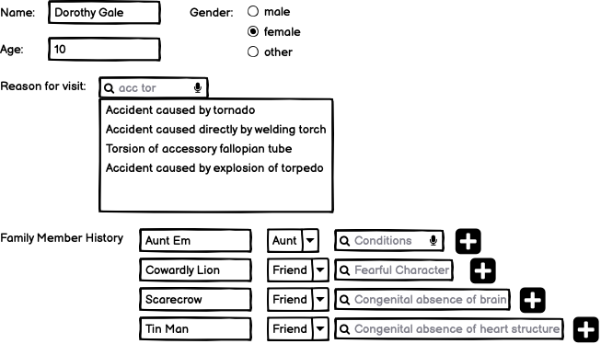
Step 1: Dorothy makes an appointment with Dr Oz

Slide 14
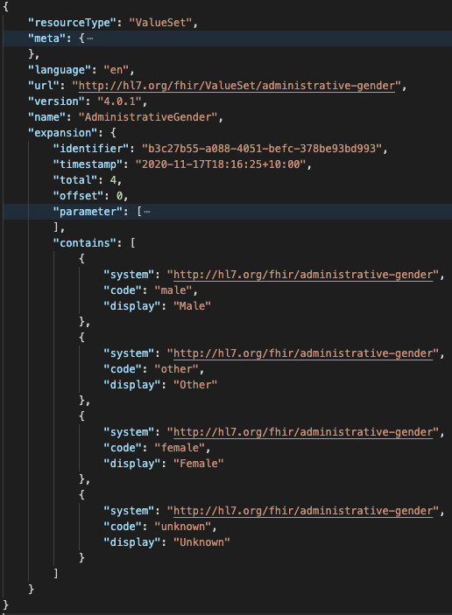
Get gender options
GET ValueSet/$expand? url= http://hl7.org/fhir/ValueSet/administrative-gender

Slide 15
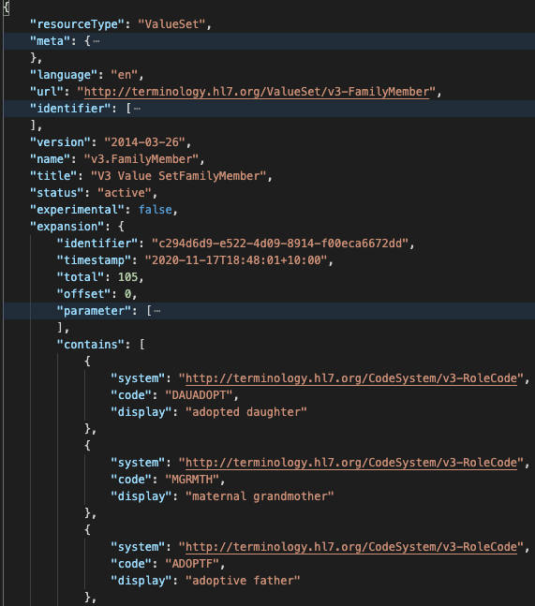
Get Family Member Relationships
GET ValueSet/$expand?context=FamilyMemberHistory.relationship

Slide 16
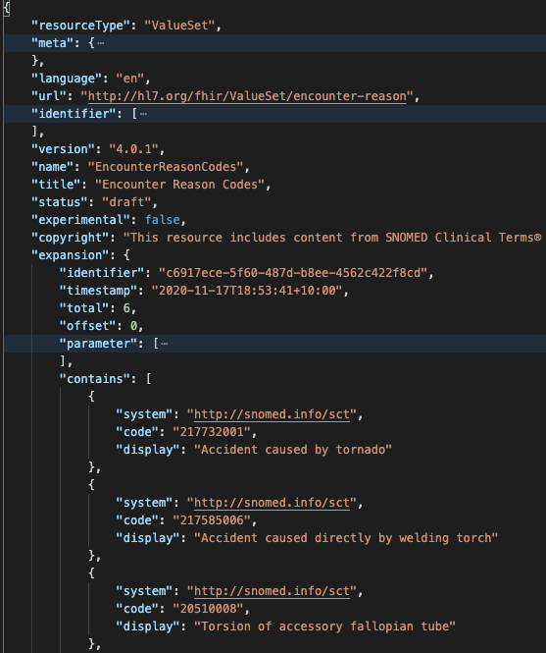
Search for reason for visit
GET ValueSet/$expand? context=Encounter.reasonCode& filter=acc tor

Slide 17
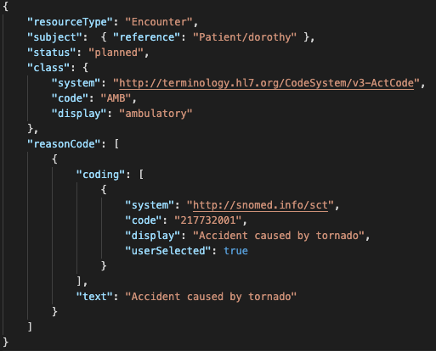
code
Coding
CodeableConcept

Slide 18
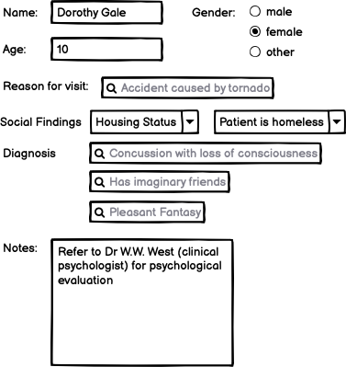
Step 2. Dr Oz makes his record

Slide 19
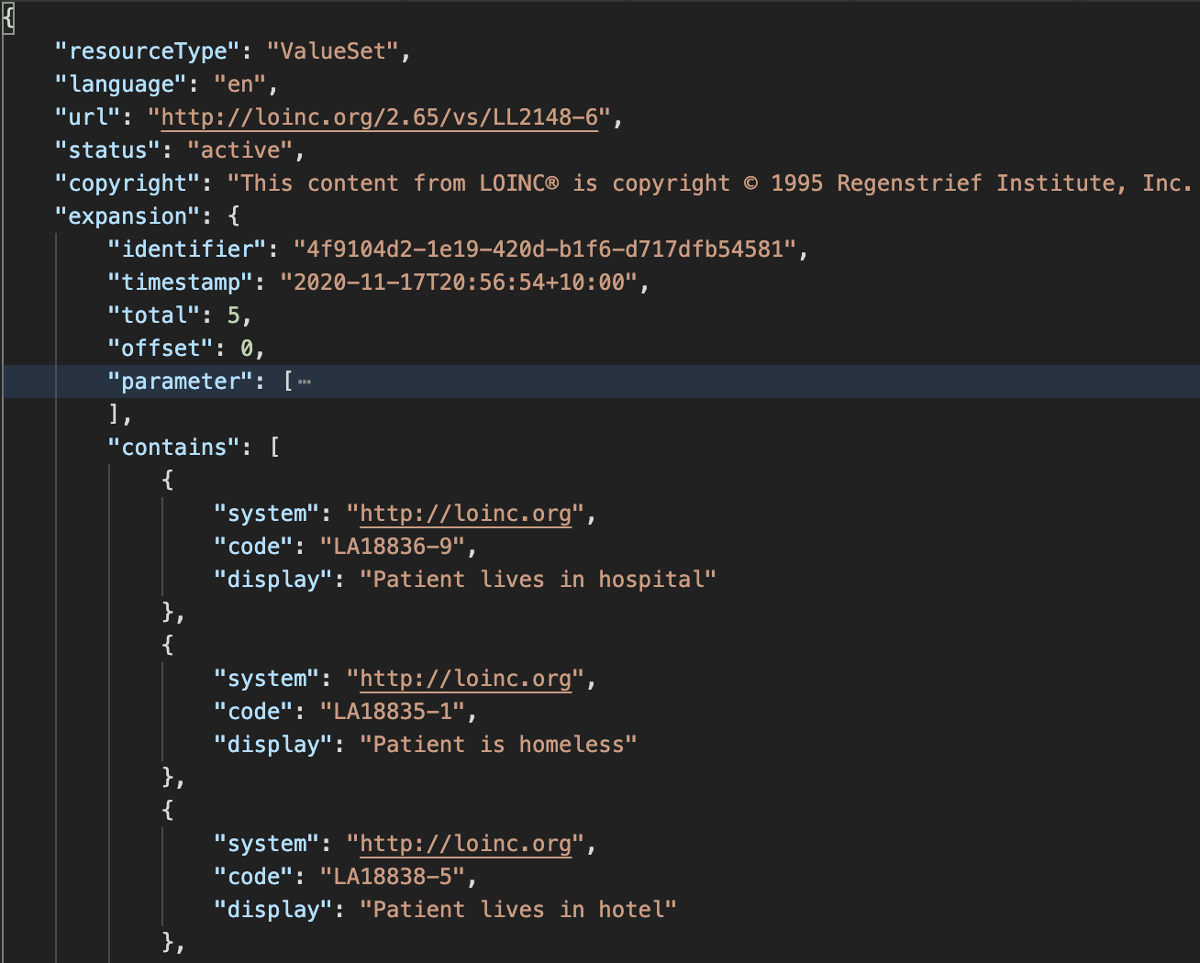
Selecting housing status
GET /ValueSet/$expand?url=http://loinc.org/vs/LL2148-6

Slide 20
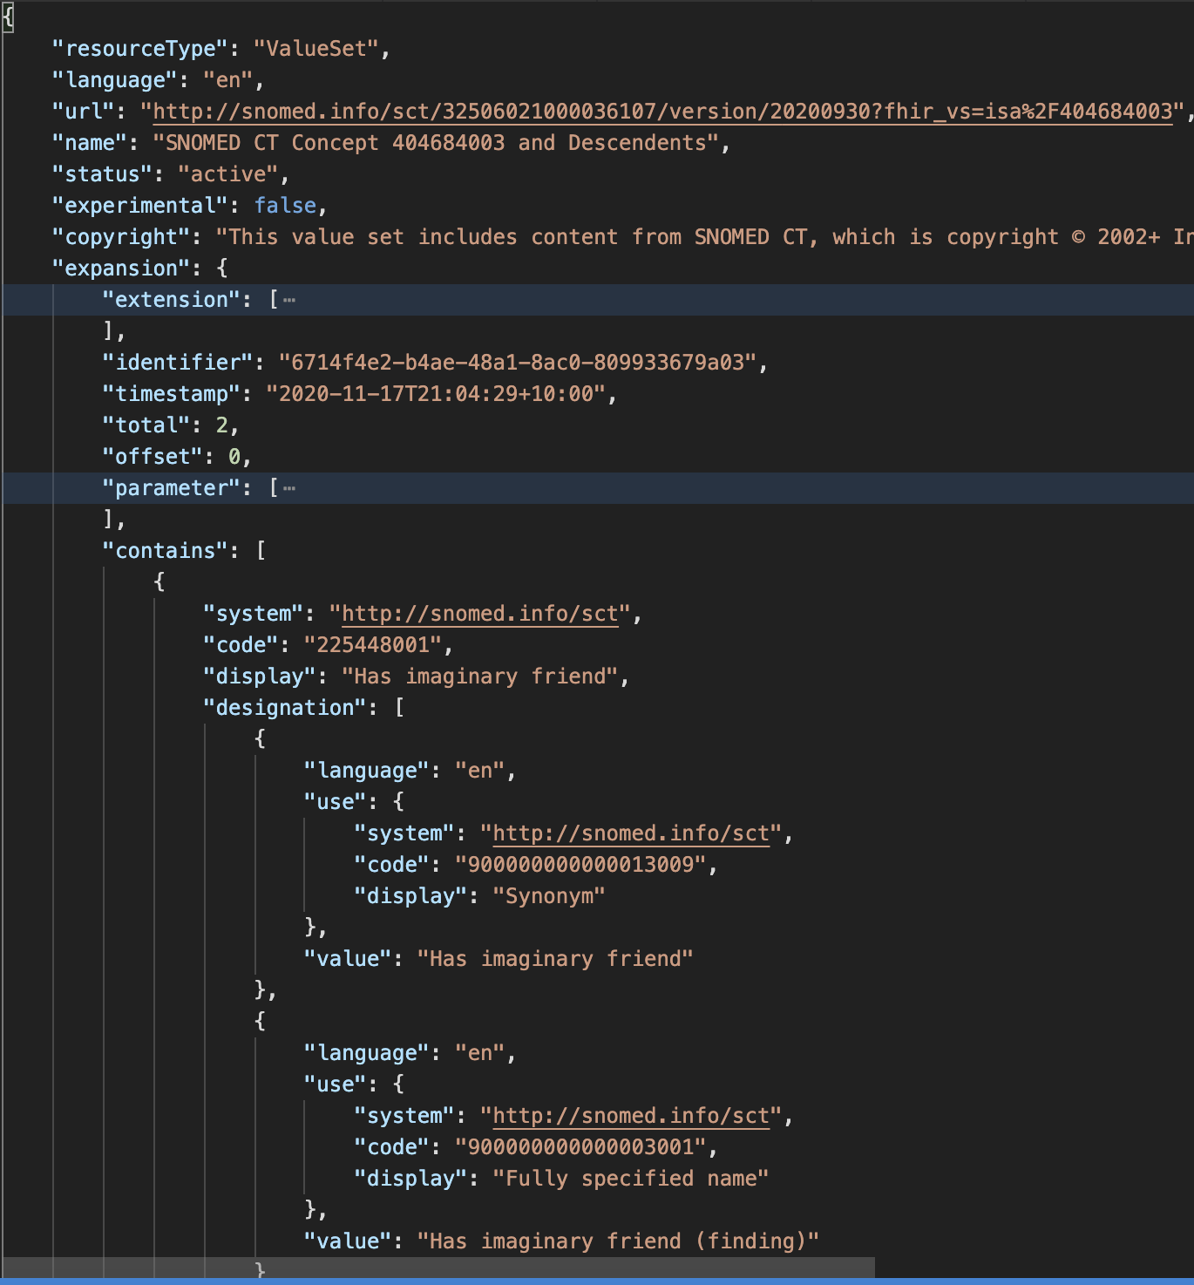
Selecting diagnosis codes
GET /ValueSet/$expand? url=http://snomed.info/sct?fhir_vs=isa/404684003& count=10& offset=0& includeDesignations=true& filter=imagina

Slide 21

Step 3. Dr Oz sends his record to Dr West
Dr West’s EMR validates the resources when they arrive
Dr West’s EMR probably enforces some profiles of Patient/Encounter/ServiceRequest/Condition/FamilyMemberHistory
FHIR $validate
Usually makes lots of calls to ValueSet/$validate-code

Slide 22
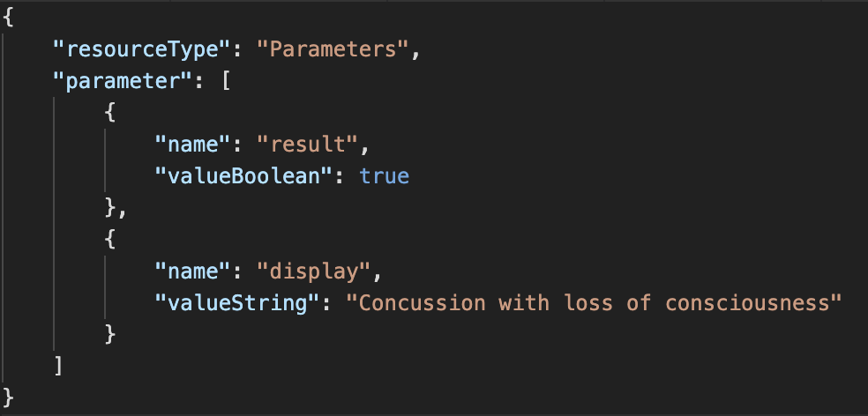
Check condition codes
GET /ValueSet/$validate-code? url=http://snomed.info/sct?fhir_vs=refset/32570071000036102& system=http://snomed.info/sct& code=62564004

Slide 23
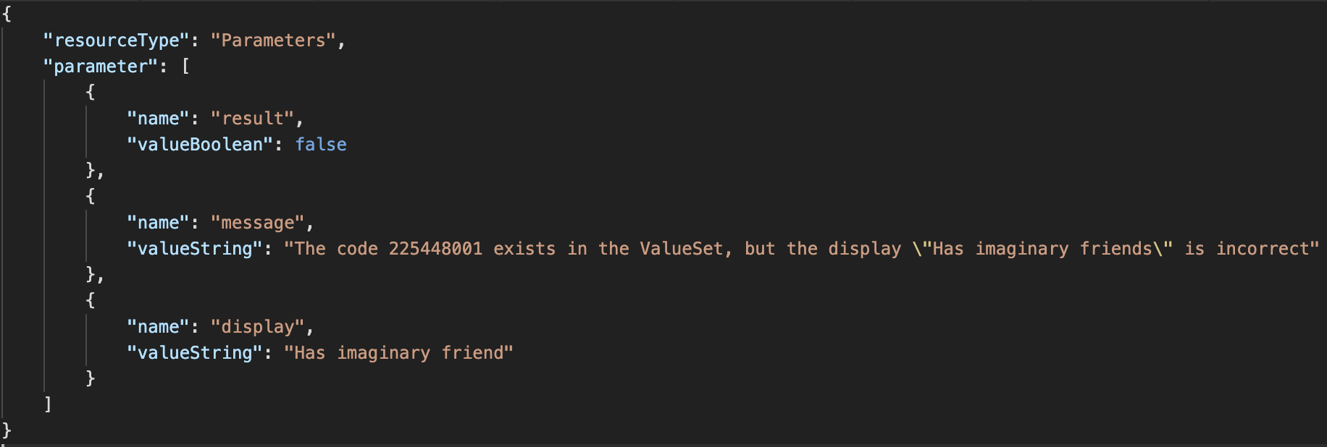
Check condition codes
GET /ValueSet/$validate-code? url=http://snomed.info/sct?fhir_vs=refset/32570071000036102& system=http://snomed.info/sct& code= 225448001& display=Has imaginary friends

Slide 24
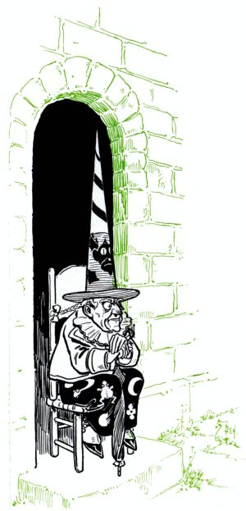
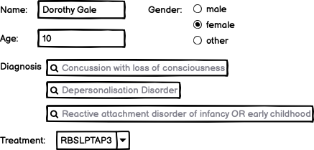
Step 4. Dr West completes her record

Slide 25
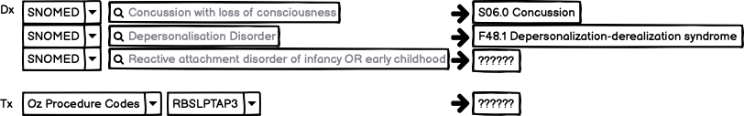
Step 5. Dr West submits her record to the HIE

Slide 26
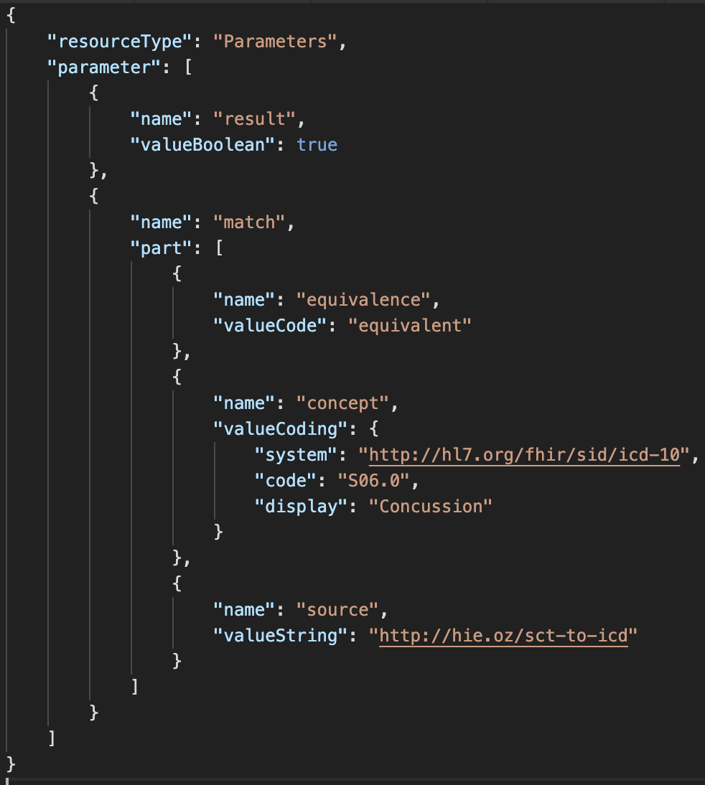
Map SNOMED codes to ICD-10 (using some ConceptMap)
GET /ConceptMap/$translate? url=http://hie.oz/sct-to-icd& target=http://hl7.org/fhir/sid/icd-10/vs& system=http://snomed.info/sct& code=62564004

Slide 27
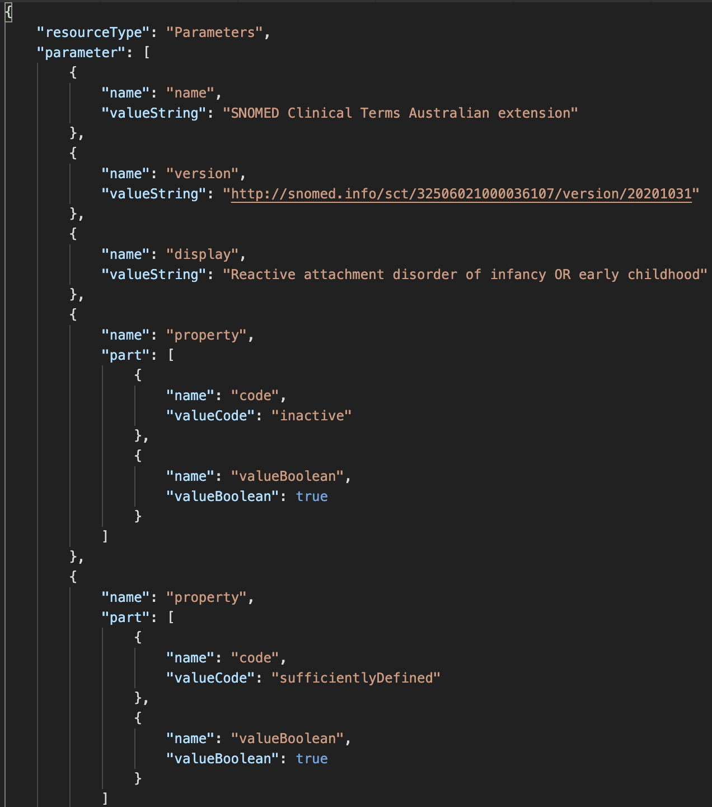
What about that unmapped code?
GET /CodeSystem/$lookup? system=http://snomed.info/sct& code=28857002

Slide 28
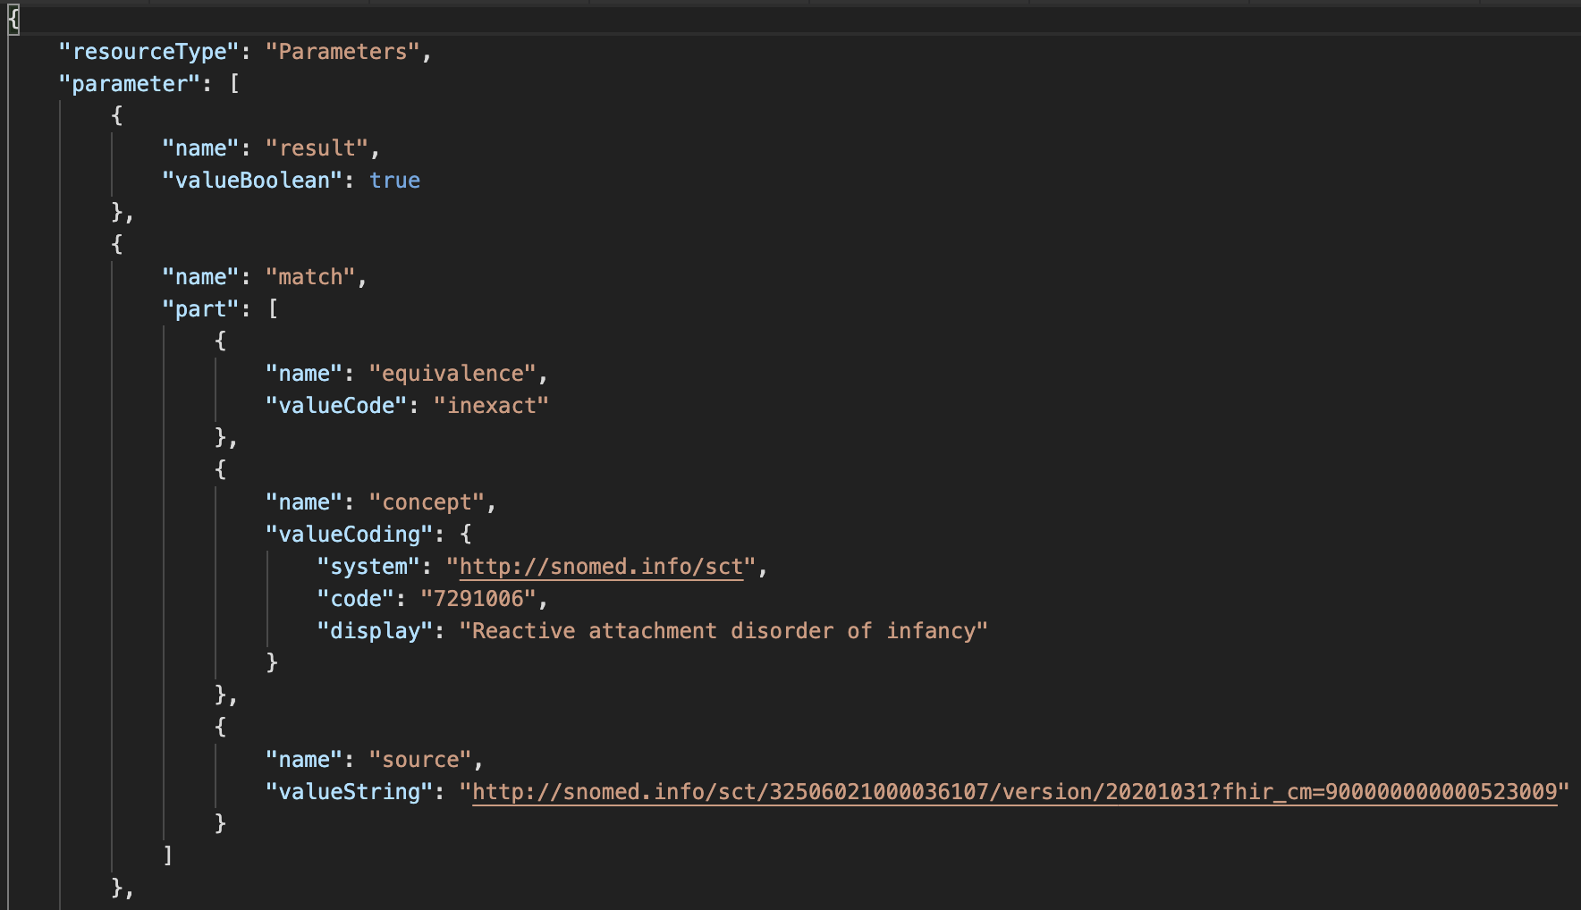
What was this inactive SNOMED CT code replaced by?
GET /ConceptMap/$translate? url=http://snomed.info/sct?fhir_cm=900000000000523009& target=http://snomed.info/sct?fhir_vs& system=http://snomed.info/sct& code=62564004

Slide 29
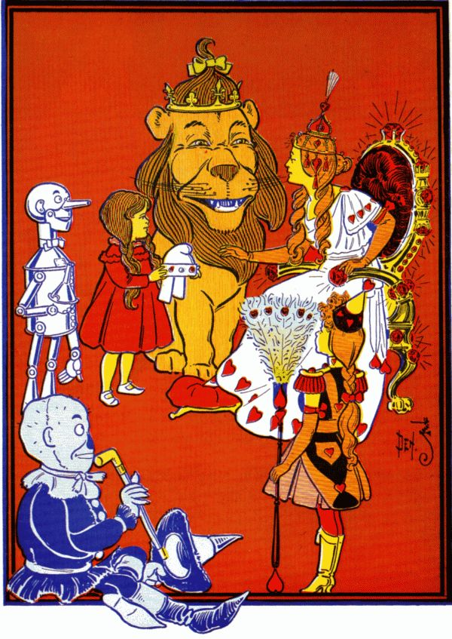
Step 6. Glinda Goodwitch is doing some analytics
She wants to find what treatment paths are being used for patients with mental health conditions
She starts with all SCT Mental Illnesses
http://snomed.info/sct?fhir_vs=isa/74732009

Slide 30
Step 7. Glinda refines her cohort
She’s finding too many drunken munchkins
She’s also not interested in intellectual disabilities for this study, so …
Glinda makes her own ValueSet!

Slide 31
Making a ValueSet compose
We have 4 “building blocks” criteria
a whole code system
members of another ValueSet
specific codes from a code system
a filter (property, op, value)
Multiple criteria in the same include/exclude
AND/intersection
E.g. Only members of an included ValueSet that satisfy a filter
Multiple separate include/excludes
OR/union
E.g. members of an included ValueSet as well as codes that satisfy a filter
All includes are processed before excludes

Slide 32
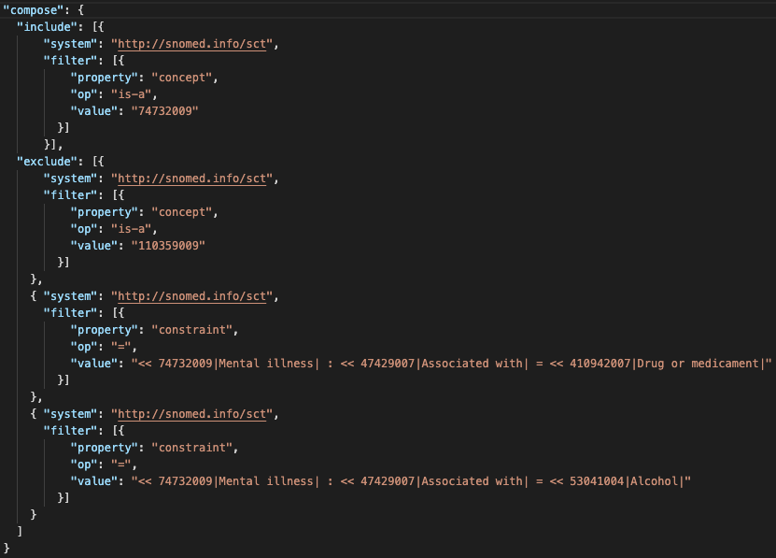

Slide 33
Glinda’s FHIR server
/Patient?_has:Condition:subject:code:below=74732009
Maybe Glinda’s server is using $closure to keep a local cache of subsumption relationships among the codes it knows about.
Maybe Glinda’s server has some virtualized tables that sync with the terminology server periodically
/Patient?_has:Condition:subject:code:in=http://hie.oz/mental-health
Unfortunately there is no $closure equivalent for ValueSet membership
If the server is limited to only known ValueSet urls, then maybe it maintains a cache. Otherwise, maybe it just asks the server (e.g. for the intersection of the ValueSet and the server’s known Condition codes)

Slide 34
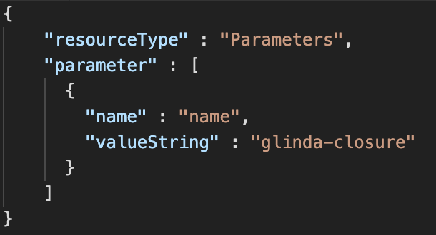
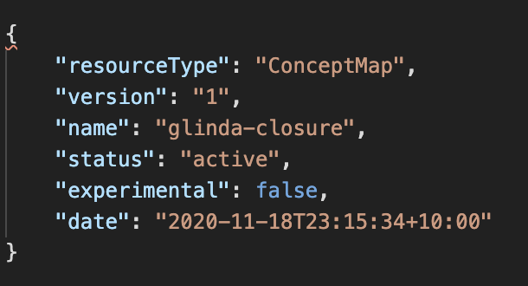
$closure (1/3)

Slide 35
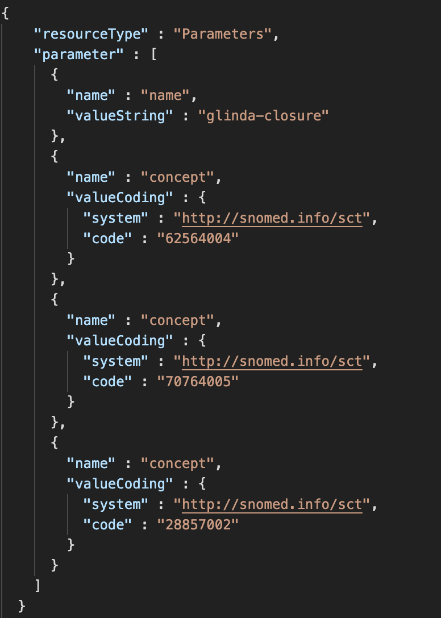
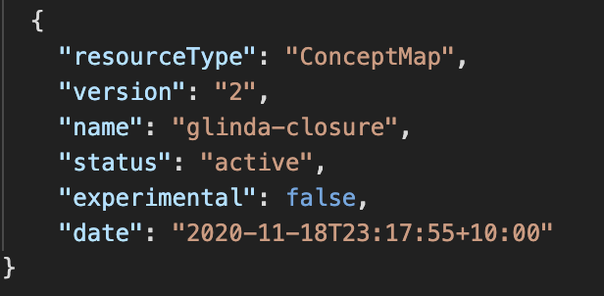
$closure (2/3

Slide 36
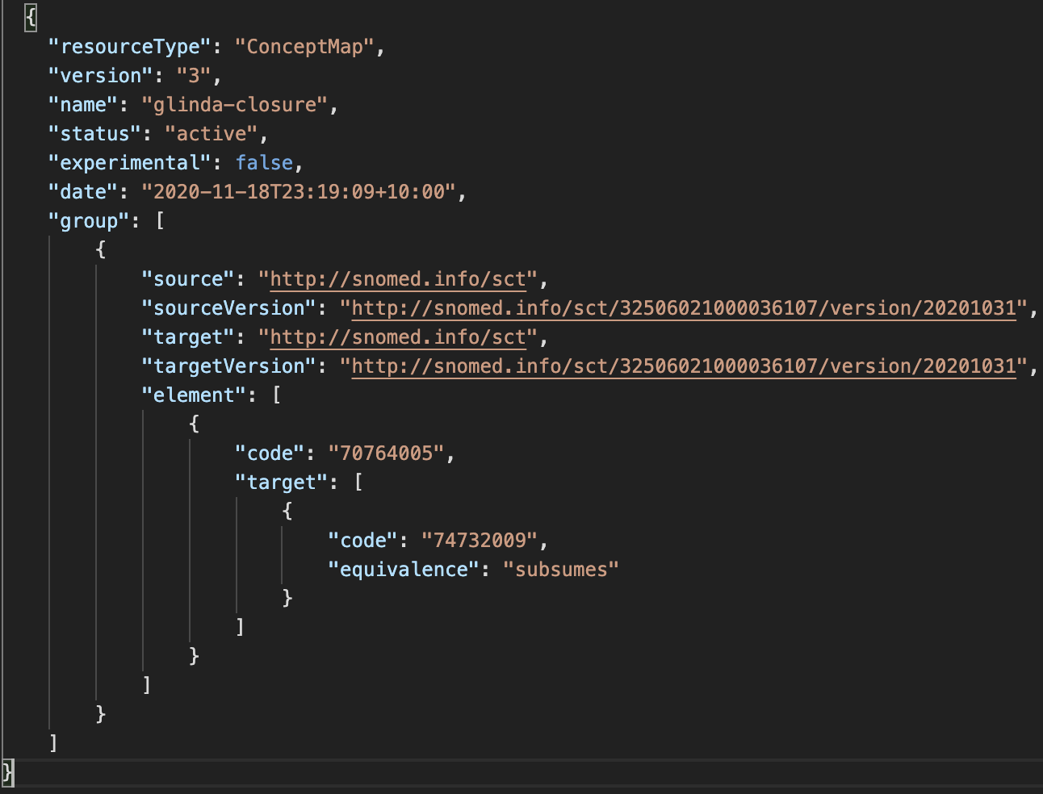
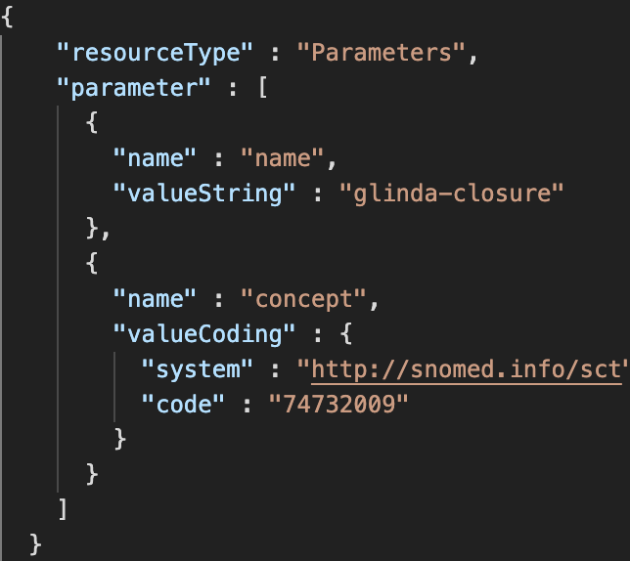
$closure (3/3)

Slide 37
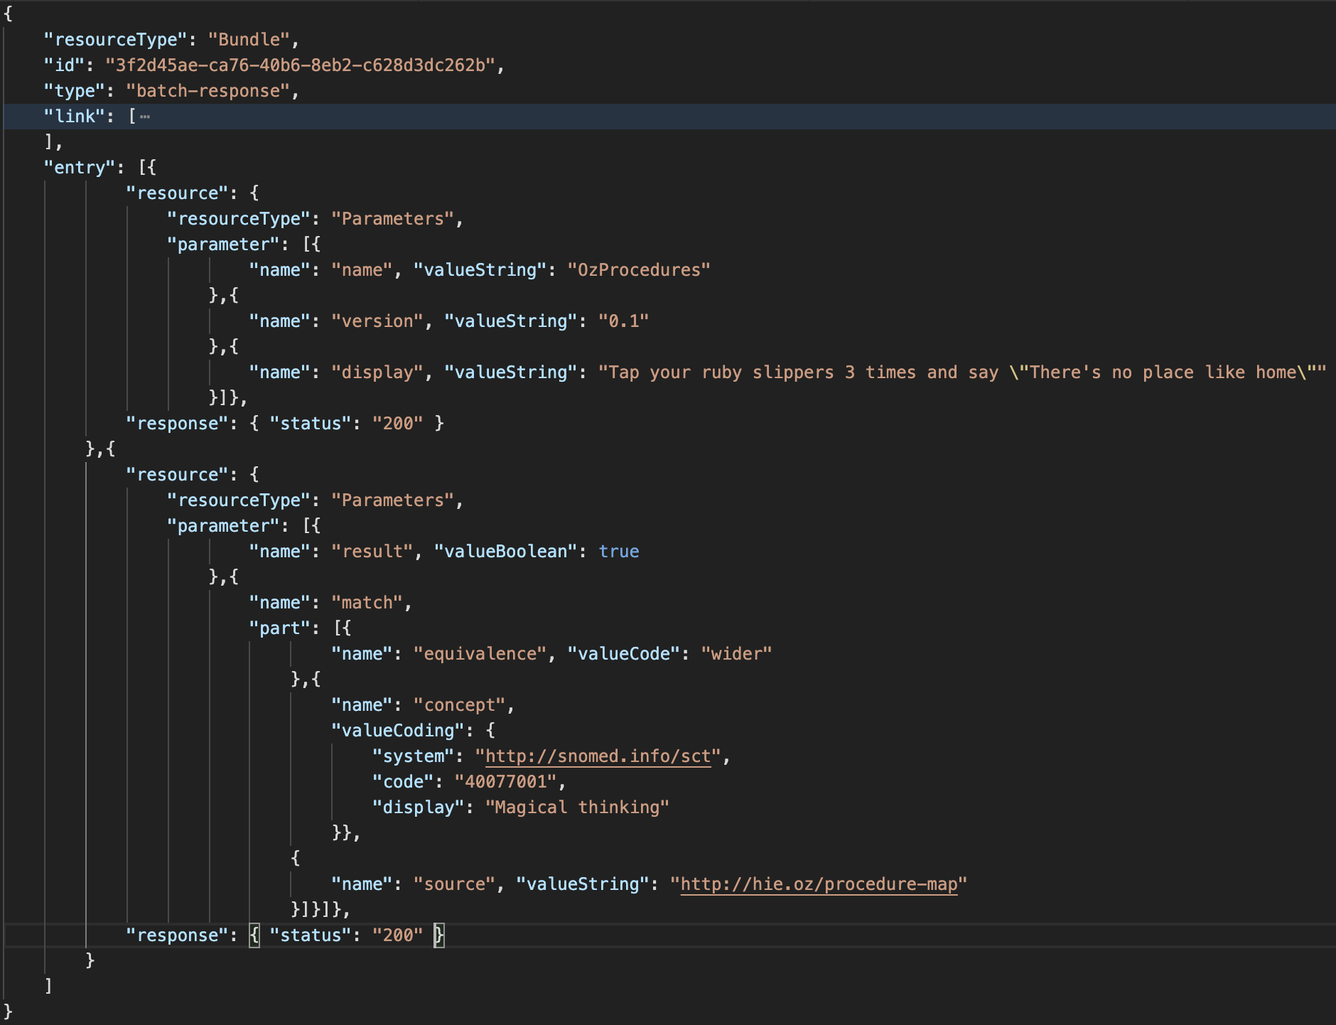
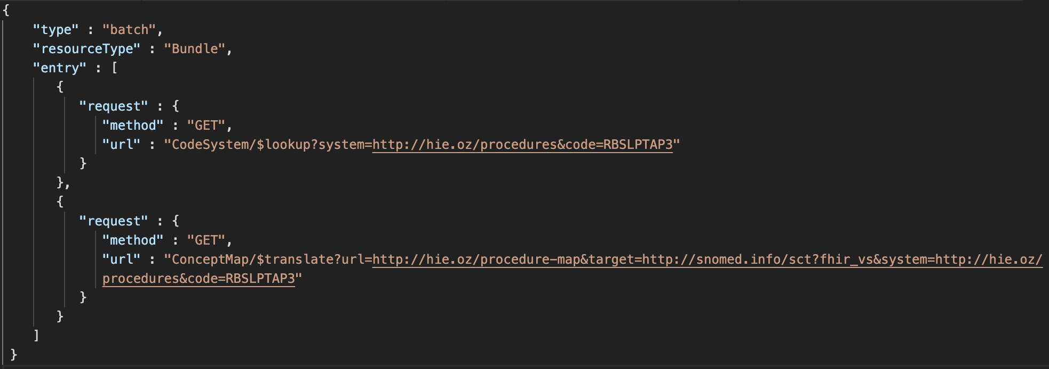
Glinda finds Dorothy!

Slide 39
What have we learned?
Some of the terminology operations in the FHIR and what they do
$expand
List all the codes in a ValueSet, or search for a code in a ValueSet
$validate-code
Test whether a code is in a ValueSet, and test whether its display text is correct
$translate
Use a ConceptMap to find what a code maps to
$lookup
Find details about a code

Slide 40
What have we learned?
A quick example of making your own ValueSet
Some hopes for integration of FHIR and terminology servers!

Slide 41
Further advanced topics for exploration

Slide 42
FHIR terminology service operations – new $expand capability

Slide 43
$expand - new R5 ‘property’ feature
The additional parameter property can be supplied to $expand to request that the values for specified properties are also returned in the expansion (if they exist)
For FHIR R4, Because there is no ‘property’ element defined in ValueSet.expansion.contains, the Extension element http://hl7.org/fhir/5.0/StructureDefinition/extension-ValueSet.expansion.contains.property is used
Example (from CSIRO Ontoserver)

Slide 44
Terminology-based searching techniques

Slide 45
Search parameters
Value Set-based Modifiers
ValueSet used in example
https://fhir.hausamconsulting.com/r4/ValueSet/upper-respiratory-infection
https://fhir.hausamconsulting.com/r4/ValueSet/upper-respiratory-infection/$expand
Code in value set: in
https://fhir.hausamconsulting.com/r4/Condition?code:in=http%3A%2F%2Fexample.org%2Fvs%2Fupper-respiratory-infection

Slide 46
Search parameters
Value Set-based Modifiers
Code not in value set: not-in
https://fhir.hausamconsulting.com/r4/Condition?code:not-in=http%3A%2F%2Fexample.org%2Fvs%2Fupper-respiratory-infection
Not sufficiently supported with current server implementations (most or all?)

Slide 47
Search parameters
Subsumption-based Modifiers
Code in a resource subsumes the specified search code (e.g. is-a* relationship): below “Diabetes mellitus” (73211009)
https://fhir.hausamconsulting.com/r4/Condition?code:below=http://snomed.info/sct|73211009
Code in a resource is subsumed by the specified search code (e.g. is-a* relationship): above “Diabetes mellitus type 2 without retinopathy” (1481000119100)
https://fhir.hausamconsulting.com/r4/Condition?code:above=http://snomed.info/sct|1481000119100
*’is-a’ relationship includes the code itself

Slide 48
Using SNOMED CT Expression Constraint Language (ECL) in value set definitions

Slide 49
SNOMED CT Expression Constraint Language (ECL)
A SNOMED CT Expression Constraint is a computable rule that can be used to define a bounded set of clinical meanings represented by either precoordinated or postcoordinated expressions.
SNOMED CT ECL documentation
Not all FHIR servers support ECL!
Ontoserver, Snowstorm and Terminz servers do support ECL

Slide 50
SNOMED CT Expression Constraint Language (ECL) (cont.)
Expressions
http://hl7.org/fhir/snomedct.html#4.3.1.0.5
ECL
See SNOMED CT Filters
See SNOMED CT Implicit Value Sets (fifth bullet in second set)
(This page was moved from the FHIR specification to THO as of R5)
SNOMED CT Browser
Expression Constraint Queries tab

Slide 51
SNOMED CT Expression Constraint Language (ECL) (cont.)
SNOMED ECL Builder (OntoServer)
https://ontoserver.csiro.au/shrimp/ecl/
CSIRO Value Set Comparison Tool
Includes several ECL queries and shows responses (or lack of response) from multiple FHIR servers
http://ontoserver.csiro.au/vstool

Slide 52

ECL Value Set Definition Example
https://build.fhir.org/ig/HL7/fhir-ips/ValueSet-procedures-snomed-ct-ips-free-set.html
POST the ValueSet resource to a server endpoint and invoke the $expand operation (show in VS Code and Postman)

Slide 53
Using FHIR implicit value sets

Slide 54
Implicit Value Sets
Implicit value sets are those whose specification can be predicted based on the grammar of the underlying code system, and the known structure of the URL that identifies them
New documentation on this in ValueSet resource in R5 ballot
Note: There is current ongoing discussion in the Terminology Infrastructure (TI) WG about further revising this description/documentation to make it (hopefully!) more clear – feedback to the TI WG is welcome and encouraged!

Slide 55
Implicit Value Sets
Implicit value sets do not use complex queries
Allows a single URL to serve as a value set definition (without requiring an explicit ValueSet resource)
Can serve as the basis for the $expansion operation
Example - SNOMED CT has common sets of implicit value sets defined (more than any other code system at present):
By Subsumption, By Reference Set, etc.
See https://terminology.hl7.org/SNOMEDCT.html#snomed-ct-implicit-value-sets

Slide 56
Implicit Value Set $expand (isa)
SNOMED CT subtypes of “Pneumonia” (233604007)
https://r4.ontoserver.csiro.au/fhir/ValueSet/$expand?url=http%3A%2F%2Fsnomed.info%2Fsct%3Ffhir_vs=isa%2F233604007&_format=json&_pretty=true
http://tx.fhir.org/r4/ValueSet/$expand?url=http%3A%2F%2Fsnomed.info%2Fsct%3Ffhir_vs=isa%2F233604007
https://terminz.azurewebsites.net/fhir/ValueSet/$expand?url=http%3A%2F%2Fsnomed.info%2Fsct%3Ffhir_vs=isa%2F233604007&_format=json&_pretty=true

Slide 57
Implicit Value Set $expand (ECL expression)
SNOMED CT subtypes of “Pneumonia” (233604007) ECL expression: < 233604007 |Pneumonia (disorder)|
https://r4.ontoserver.csiro.au/fhir/ValueSet/$expand?url=http%3A%2F%2Fsnomed.info%2Fsct%2F900000000000207008%2Fversion%2F20220731%3Ffhir_vs%3Decl%2F%3C%20233604007%20%7CPneumonia%20%28disorder%29%7C&_format=json&_pretty=true

Slide 58
Features and uses of code system supplements and fragments

Slide 59
Code System Supplements and Fragments
Supplement
CodeSystem.content = ‘supplement’
http://hl7.org/fhir/codesystem.html#supplements
Fragment
CodeSystem.content = ‘fragment’
http://hl7.org/fhir/codesystem.html#fragments

Slide 60
Code System Supplement
CodeSystem.supplements SHALL have a value – the URL of the code system being supplemented
CodeSystem.url SHALL never appear in a Coding.system
CodeSystem.url must be under control of the authority creating or publishing the supplement (usually different from the original code system)

Slide 61
Code System Supplement
Cannot define any new CodeSystem.concept.code
All instances of CodeSystem.concept.code in the supplement must be a code from the "supplemented" code system
Note: If need to define new concepts/codes to use as property values, the supplement can be paired with a new (possibly contained) Code System and use the Coding type for the property values

Slide 62
Code System Supplement Example
CodeSystem
https://terminz.azurewebsites.net/fhir/CodeSystem/bundle-type?_format=json&_pretty=true
https://terminz.azurewebsites.net/fhir/CodeSystem/bundle-type-german?_format=json&_pretty=true
https://terminz.azurewebsites.net/fhir/CodeSystem?supplements=http://hl7.org/fhir/bundle-type&_format=json&_pretty=true

Slide 63
Code System Supplement Example
ValueSet
https://terminz.azurewebsites.net/fhir/ValueSet/Bundle-Type-supplemented?_format=json&_pretty=true
Value set expansion
https://terminz.azurewebsites.net/fhir/ValueSet/Bundle-Type-supplemented/$expand?_format=json&_pretty=true

Slide 64
Code System Supplement Discussions
FHIR Zulip chat
Behaviour of CodeSystem operations with supplements
Designations from code system supplements in Coding.display?
Designations vs. language-specific resources for VS and CS

Slide 65
Code System Fragment
Reasons for using a code system fragment
Different IP distribution rules for different parts of the code system
Special purpose modules for specific purposes
Distribution of proposed content for evaluation

Slide 66
Code System Fragment
Rules for code system fragments
SHALL have the same CodeSystem.url
Can only(?) be published by the code system authority, or according to a process defined by the authority, if they have defined one
Cannot contain codes, concepts or properties that are not found in a complete representation of the code system (if one exists)
Publishing a code system in multiple fragments can create confusion for terminology servers and terminology service consumers - need to be clear about the intent

Slide 67
Code System Fragment Examples and Discussion
Common UCUM units (?)
http://hl7.org/fhir/valueset-ucum-common.html (not CodeSystem)
But THO represents UCUM as ‘"content" : "not-present”’
SNOMED CT (?)
Each SNOMED CT edition could be considered as a fragment the entire SNOMED CT – but they aren’t represented that way
Recent (Nov 2021) discussion on this topic
Fragment / Example expansions

Slide 68
FHIR R5 ConceptMap updates

Slide 69
Summary of R5 ConceptMap changes
Element “equivalence” replaced by “relationship”
Was (10): relatedto | equivalent | equal | wider | subsumes | narrower | specializes | inexact | unmatched | disjoint
Now (5): related-to | equivalent | source-is-narrower-than-target | source-is-broader-than-target | not-related-to
The directional relationships have the direction made explicit in the code – should help avoid confusion!
group.element.target.equivalence = ‘unmatched’ replaced by group.element.noMap (boolean)
No longer necessary to create a ‘target’ when there is none!

Slide 70
Summary of R5 ConceptMap changes (2)
Now can do mappings from or to a valueSet, rather than only a single code per mapping (also in unmapped)
group.element.code OR group.element.valueSet
dependsOn and product now allow a choice of value types (not only string)
‘source’ and ‘target’ elements (references to uri or valueSet) are now renamed to ‘sourceScope’ and ‘targetScope’ to clarify their meaning and use
Other elements and descriptive text have been updated and (hopefully) clarified

Slide 71
Summary of R5 ConceptMap changes (3)
Added ConceptMap.property
With the same structure/elements as CodeSystem.property
For use in:
ConceptMap.group.element.target.property
To support capabilities like priority, order, weight, score, etc.

Slide 72
Summary of R5 ConceptMap changes (4)
Added ConceptMap.additionalAttribute
Also with the same structure/elements as CodeSystem.property
Additional data element in the source or target data model where the data will come from or be mapped to
Some mappings are based on data in addition to the source data element, where codes in multiple fields are combined to a single field (or vice versa)
For use in:
ConceptMap.group.element.target.dependsOn.attribute
ConceptMap.group.element.target.product.attribute

Slide 73
Summary of R5 $translate changes
$translate operation parameters have also been renamed to be clearer and to match the corresponding resource elements
$translate ‘source’ and ‘target’ input parameters now can specify ‘code’, ‘Coding’ or ‘CodeableConcept’ (new parameters added)

Slide 74
Summary of R5 $translate changes (2)
‘dependency’ and ‘match.product’ values can now have a choice of value types (corresponding to the resource)
‘reverse’ input parameter has been removed
This was confusing!
If both directions are needed, create maps explicitly for each direction

Slide 75
Summary of R5 $translate changes (3)
dependency.element renamed to dependency.attribute
dependency.concept renamed to dependency.value
match.source renamed to match.originMap
Added match.property and match.dependsOn (and sub-elements)

Slide 76
R5 ConceptMap server support
Ontoserver ConceptMap R5 features
R5 endpoint not available at this time?
Zulip discussion on R5 Terminology Servers

Slide 77
UTG and THO

Slide 78
Unified Terminology Governance (UTG)
UTG is a process
How to add and maintain (modify, and in rare cases remove) content in THO (terminology.hl7.org)
Submit and vote (by registered UTG voters) on UTG proposals
UTG documentation
Additional slides available – time and interest permitting

Slide 79
terminology.hl7.org (THO)
https://terminology.hl7.org/
”Source of truth” for (most) HL7 terminology
Contains code systems (HL7 and external), identifier systems (normally external), value sets (some), concept maps (actually there are none at present)
THO is not a terminology service
But THO content is provided for the FHIR core and IG build ecosystem in tx.fhir.org

Slide 80
References for Servers and tools

Slide 81
Some Publicly Available Terminology Servers
Health Intersections (Grahame Grieve)
http://tx.fhir.org/ (FHIR build terminology server)
HAPI (University Health Network – James Agnew)
http://hapi.fhir.org/
OntoServer (CSIRO – Australia – Michael Lawley)
https://ontoserver.csiro.au/
https://r4.ontoserver.csiro.au/fhir (Ontoserver R4 server)

Slide 82
Some Publicly Available Terminology Servers
Value Set Authority Center (VSAC) – US National Library of Medicine (NLM)
https://cts.nlm.nih.gov/fhir/
Requires a UMLS account
Terminz (Patients First – New Zealand – Peter Jordan)
https://terminz.azurewebsites.net/fhir
Link to other publicly available FHIR servers (general and terminology)
https://confluence.hl7.org/display/FHIR/Public+Test+Servers

Slide 83
Some Useful Tools
clinFHIR (David Hay)
CodeSystem builder
http://clinfhir.com/codeSystem.html
ValueSet explorer
http://clinfhir.com/valuesetCreator.html
Query Tool
http://clinfhir.com/query.html
Postman
https://www.getpostman.com/

Slide 84
Some Useful Tools (cont.)
Shrimp SNOMED CT browser (CSIRO)
http://ontoserver.csiro.au/shrimp
CSIRO Value Set Comparison Tool
http://ontoserver.csiro.au/vstool
FHIR Tools release page
https://github.com/HealthIntersections/fhirserver/releases

Slide 85
Questions?
Connect with the FHIR community: FHIR Zulip chat terminology stream
https://chat.fhir.org/#narrow/stream/terminology
Or ask me: Rob Hausam
rob@hausamconsulting.com rrhausam@gmail.com Or you can send me a PM on the FHIR Zulip chat

